Slide 1


Green Pace
Security Policy Presentation Developer: Samuel Alex Black Link to video: https://youtu.be/UXaDqqc0UnM

Slide 2
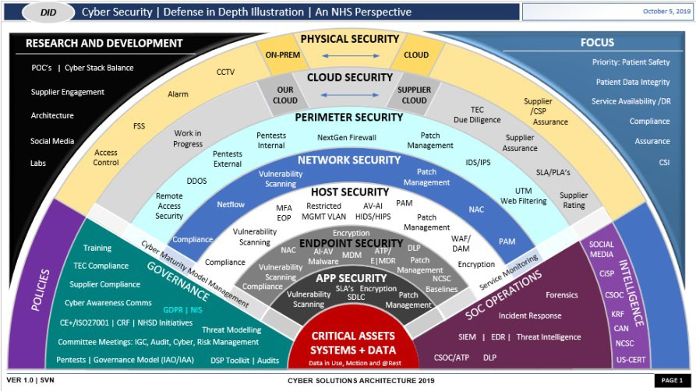

OVERVIEW: DEFENSE IN DEPTH
Purpose of Security Policy
Standardize secure coding practices
Reduce vulnerabilities in development
Support defense-in-depth strategy
Defense in Depth
Multiple layers of protection
Prevent single points of failure
Combine coding, architecture, and testing

Slide 3
THREATS MATRIX
Likely: High Likelihood / Medium Impact Weak Input Validation Integer Overflow Improper Error Handling | Priority: High Likelihood / High Impact SQL Injection Weak Authentication Buffer Overflow
Low priority: Low Likelihood / Low Impact Memory Leaks Inefficient Logging Minor Exception Handling Issues | Unlikely Low Likelihood / High Impact Race Conditions Advanced Privilege Escalation Zero-Day Exploits

Slide 4
10 PRINCIPLES
Input Validation → Validate all external input (Standard #1)
Least Privilege → Limit access rights (Standard #5)
Defense in Depth → Apply multiple layers of security (All standards)
Secure Defaults → Systems start in a secure state (Standard #10)
Fail Securely → Do not expose sensitive data on failure (Standard #4, #10)
Separation of Concerns → Isolate system components (Standard #7)
Minimize Attack Surface → Reduce exposed functionality (Standard #7, #9)
Logging and Monitoring → Track system activity (Standard #8)
Secure Communication → Protect data in transit (Encryption policies)
Continuous Testing → Validate security through testing (Unit testing + automation)

Slide 5
CODING STANDARDS
1. Input Validation – Prevent malicious input
2. Memory Safety – Prevent buffer overflows
3. Secure Authentication – Protect user access
4. Secure Error Handling – Avoid information leaks
5. Least Privilege Enforcement – Restrict access
6. Output Encoding – Prevent injection attacks
7. Secure API Usage – Use trusted libraries
8. Logging and Monitoring – Track security events
9. Dependency Management – Avoid vulnerable libraries
10. Secure Defaults – Safe system configuration
Prioritization Method:
• Based on Impact + Likelihood
• Highest priority = direct data compromise risk
• Lower priority = indirect or less frequent risks

Slide 6
ENCRYPTION POLICIES
Data in Transit → Use TLS encryption
Data at Rest → Use AES encryption
Data in Use → Protect sensitive data in memory
Rationale:
Prevent data interception (MITM attacks)
Protect stored sensitive data
Maintain confidentiality and integrity
Example:
Encrypt login credentials and user data

Slide 7
TRIPLE-A POLICIES
Authentication → Verify user identity
Authorization → Control access levels
Accounting → Log and monitor activity
Policies:
Use strong password requirements
Implement role-based access control
Track login attempts and user actions
Purpose:
Prevent unauthorized access
Support auditing and incident response

Slide 8
Unit Testing
• Validates secure and expected behavior
• Positive Tests → Confirm correct functionality
• Negative Tests → Reject invalid or malicious input
Examples:
• Input validation tests
• Exception handling tests
• Boundary value testing
Purpose:
• Detect vulnerabilities early
• Prevent regression issues

Slide 9
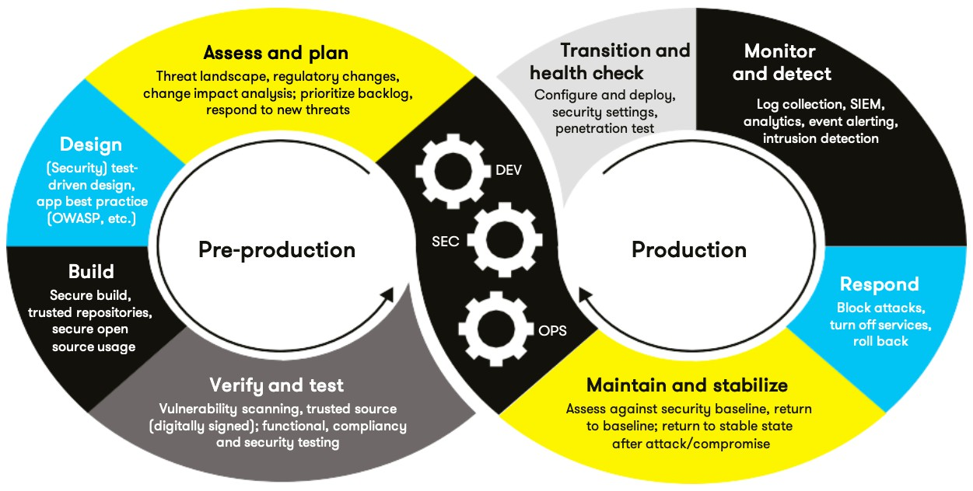
AUTOMATION SUMMARY

Slide 10
TOOLS
DevSecOps pipeline:
Security should be integrated throughout the development lifecycle using a DevSecOps approach. During development, static analysis tools such as Cppcheck help identify vulnerabilities early.During the build phase, compiler warnings highlight unsafe coding patterns. During testing, automated unit tests validate both functionality and security behavior.This continuous integration of security ensures vulnerabilities are detected and addressed as early as possible.
Cppcheck → Static code analysis
Compiler Warnings → Detect unsafe code
Google Test → Unit testing framework
Benefits:
Early vulnerability detection
Improved code quality
Reduced security defects

Slide 11
RISKS AND BENEFITS
Fix Now:
SQL Injection
Weak Authentication
Buffer Overflow
Fix Later:
Minor logging issues
Performance-related concerns
Benefits:
Reduced breach risk
Improved system reliability
Increased trust and compliance

Slide 12
RECOMMENDATIONS
• Integrate security into all development stages
• Prioritize vulnerabilities by impact and likelihood
• Expand automated testing and scanning
• Provide secure coding training
• Regularly update security policies

Slide 13
CONCLUSIONS
• Security must be proactive, not reactive
• Prioritize high-risk vulnerabilities first
• Use layered defense strategies
• Continuously improve security practices

Slide 14
REFERENCES
McAfee. (2021). 7 types of hacker motivations. https://web.archive.org/web/20210413134404/https://www.mcafee.com/blogs/consumer/family-safety/7-types-of-hacker-motivations/
OWASP Foundation. OWASP Top 10.
https://owasp.org/www-project-top-ten/
NIST. Security and Privacy Controls.
https://csrc.nist.gov/publications/detail/sp/800-53/rev-5/final

